Slide 1

ANGULAR 4

Slide 2
Services, Dependency Injection, and Component Lifecycle Hooks
Services, DI, and Lifecycle Hooks
Services
Refactoring for Services
Dependency Injection
Injectors
Component Lifecycle Hooks
Implementing Lifecycle Hooks and Their Interfaces

Slide 3
Services, Dependency Injection, and Component Lifecycle Hooks
Services, DI, and Lifecycle Hooks

Slide 4
Services, Dependency Injection, and Component Lifecycle Hooks
Code reuse
Structural integrity

Slide 5
Services, Dependency Injection, and Component Lifecycle Hooks
Services

Slide 6
Services, Dependency Injection, and Component Lifecycle Hooks
A service provides anything our application needs.
It often share data or functions between other Angular features.

Slide 7
Services, Dependency Injection, and Component Lifecycle Hooks
ship.service.ts
@Injectable()
export class shipService {
getShips() {
return [
new Ship(10, ‘Millenium Falcon’),
new Ship(12, ‘x-Wing Fighter’),
new Ship(14, ‘TIE Fightter’)
];
}
}
Shared data or logic

Slide 8
Services, Dependency Injection, and Component Lifecycle Hooks
Refactoring for Services

Slide 9
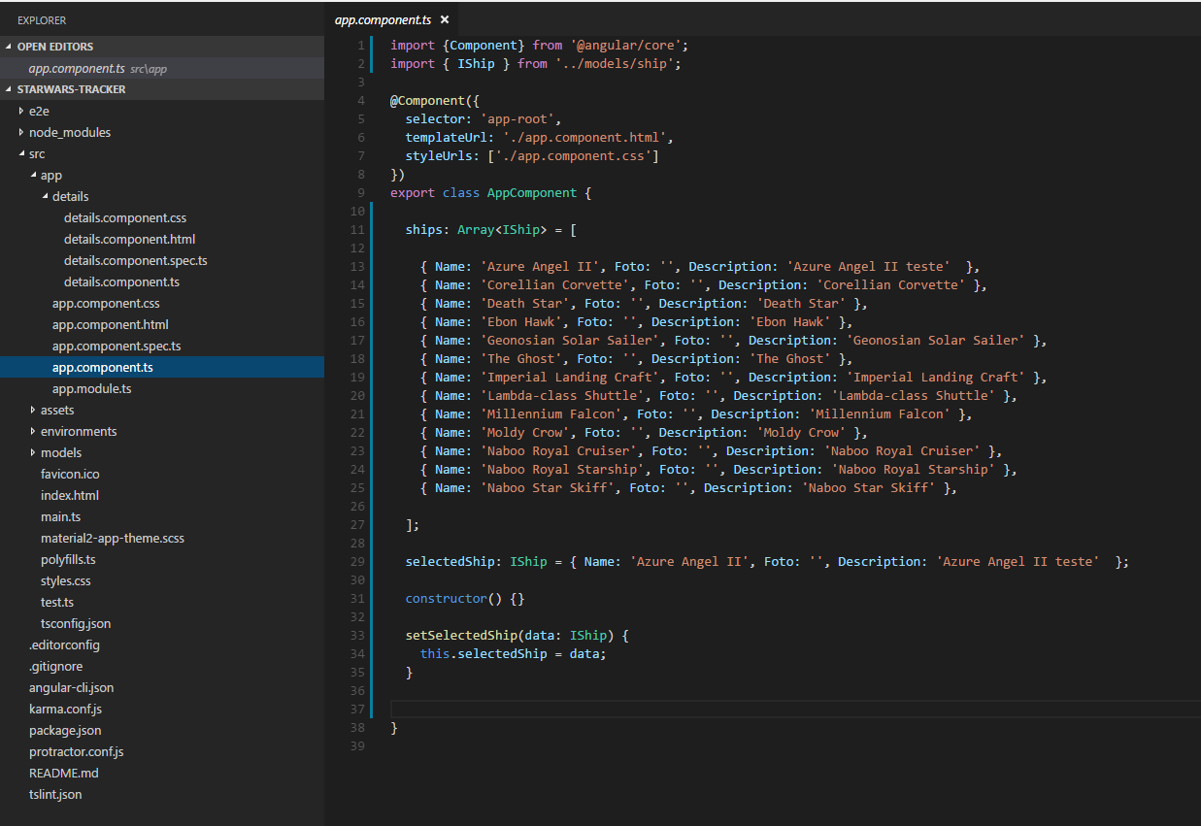
Services, Dependency Injection, and Component Lifecycle Hooks

Slide 10
Services, Dependency Injection, and Component Lifecycle Hooks
DEMO
Create a service class and refactor the Component

Slide 11
Services, Dependency Injection, and Component Lifecycle Hooks
Dependency Injection

Slide 12
Services, Dependency Injection, and Component Lifecycle Hooks
Dependency Injection is how we provide an interface of a class to another angular feature.

Slide 13
Services, Dependency Injection, and Component Lifecycle Hooks
Component
Service
{constructor(service)}

Slide 14
Services, Dependency Injection, and Component Lifecycle Hooks
Ship-list.component.ts
export class shipListComponent {
ships: Ships[];
constructor(private shipService: ShipService) {}
}
Injecting a Service into a Component
Locates the service in na Angular injector
Injects the service into the constructor

Slide 15
Services, Dependency Injection, and Component Lifecycle Hooks
Injecting a Service into a Service
ship.service.ts
In order to have DI, we need to decorate our class.
@Injectable()
export class shipService {
constructor(private http: Http) {}
getShips() {
return [
new Ship(10, ‘Millenium Falcon’),
new Ship(12, ‘x-Wing Fighter’),
new Ship(14, ‘TIE Fightter’)
];
}
}

Slide 16
Services, Dependency Injection, and Component Lifecycle Hooks
We need to provide the service to na Angular injector.
app.module.ts
@NgModule({
imports: [
BrowserModule,
FormsModule
],
declarations: [ShipComponent],
provides: [ShipServices]
bootstrap: [ShipComponent]
})
export class AppModule { }

Slide 17



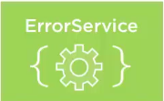
Services, Dependency Injection, and Component Lifecycle Hooks
Component
{constructor(Service)}
Injector

Slide 18
Services, Dependency Injection, and Component Lifecycle Hooks
DEMO
Add the service reference to the componente.

Slide 19
Services, Dependency Injection, and Component Lifecycle Hooks
Injectors

Slide 20
Services, Dependency Injection, and Component Lifecycle Hooks
We provide services to Angular’s Injectors
When we inject a service, Angular searches the appropriate injectors for it.

Slide 21
Services, Dependency Injection, and Component Lifecycle Hooks
One injector for the application root
And a hierarchical DI system with a tree of injectors that parallel na applications’s componente tree.

Slide 22
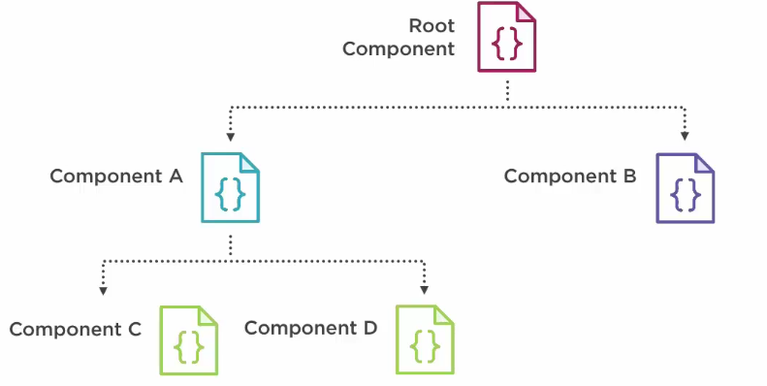
Services, Dependency Injection, and Component Lifecycle Hooks
Hierarchical Components, Hierarchical Injectors

Slide 23
Services, Dependency Injection, and Component Lifecycle Hooks
Where do we set the providers?
In the componente or na Angular Module?

Slide 24
Services, Dependency Injection, and Component Lifecycle Hooks
Providing in a Component
@Component({
selector: ‘ship-list’,
templateUrl: ‘ships-list.componente.html’,
providers: [shipService]
})
export class shipService {
//…
}
Available to this Component and any in its tree.

Slide 25
Services, Dependency Injection, and Component Lifecycle Hooks
Providing in a Angular Module
@NgModule({
imports: [
BrowserModule,
FormsModule
],
declarations: [ShipComponent],
provides: [ShipServices]
bootstrap: [ShipComponent]
})
export class AppModule { }

Slide 26
Services, Dependency Injection, and Component Lifecycle Hooks
DEMO
Provide the service to the injector

Slide 27
Services, Dependency Injection, and Component Lifecycle Hooks
Component Lifecycle Hooks

Slide 28
Services, Dependency Injection, and Component Lifecycle Hooks
Component Lifecycle hooks
Lifecycle hooks allow us to tap into specific moments in the application lifecycle to perform logic.

Slide 29
Services, Dependency Injection, and Component Lifecycle Hooks
Implement the lifecycle hook’s OnInit interface
@Component({
selector: ‘ship-list’,
templateUrl: ‘ships-list.componente.html’,
})
export class shipService implements OnInit {
ngOnInit() {
//….
}
}

Slide 30
Services, Dependency Injection, and Component Lifecycle Hooks
Component
Lifecycle
2
1
ngOnInit
ngOnChanges
ngAfterViewInit
ngOnChanges
ngOnDestroy
3
5
4

Slide 31
Services, Dependency Injection, and Component Lifecycle Hooks
Implementing Lifecycle Hooks and Their Interfaces

Slide 32
Services, Dependency Injection, and Component Lifecycle Hooks
@Component({
selector: ‘ship-list’,
templateUrl: ‘ships-list.componente.html’,
})
export class shipService implements OnChanges, OnInit, AfterViewInit, OnDestroy {
ngOnInit() {
//….
}
}

